Slide 1
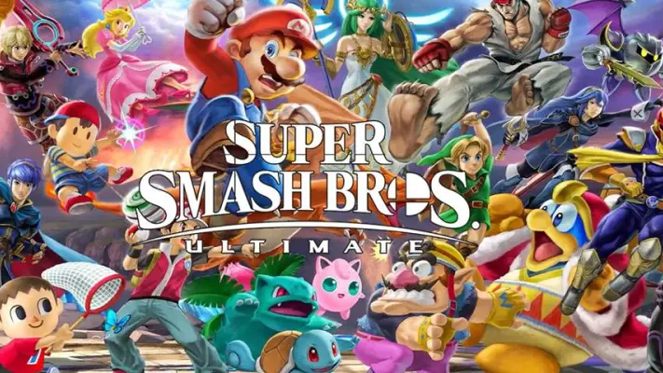
Smash Brothers API
Cody Donner
David Lee
Kathlyn Huynh

Slide 2
Sources
https://kuroganehammer.com/
https://ssbworld.com/characters/win-percentage/

Slide 3
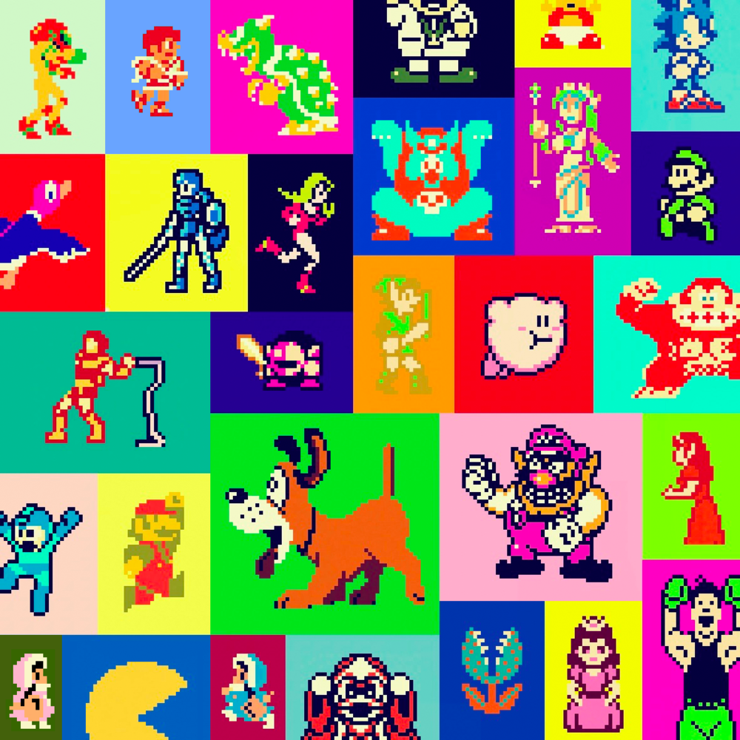
Analysis: SSBU Character Movement Attributes
Character attributes that are accounted for:
Base Air Acceleration
Additional Acceleration
Max Acceleration
Max Air Speed
Max Fall Speed
Fast Fall Speed
Speed Increase
Walk Speed
Initial Dash
Weight

Slide 4
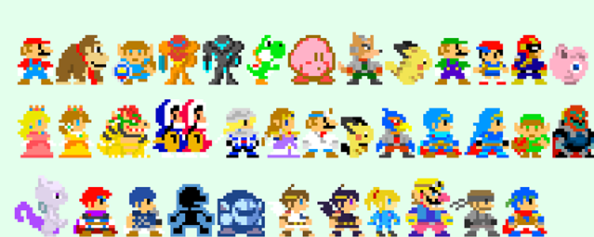
Hypothesis:
Does movement based character attribute affect win rate?
The higher the maneuverability, the more likely the character is to win.
Unless you just suck at playing the game, then character stats don’t matter.

Slide 5
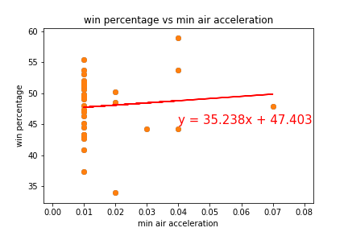
Base Air Acceleration
The correlation between the minimum air acceleration and win rate is 0.09124695490489977
The standard deviation between the minimum air acceleration and win rate is 0.008326006779416813
The pvalue between the minimum air acceleration and win rate is 0.6077916849475764

Slide 6

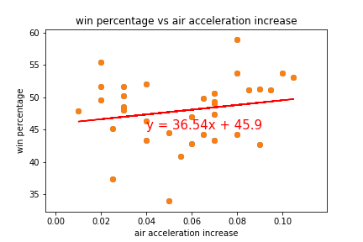
Additional Acceleration
The correlation between the air acceleration increase and win rate is 0.189563811173329
The standard deviation between the air acceleration increase and win rate is 0.03593443850655753
The pvalue between the air acceleration increase and win rate is 0.2829274131626914

Slide 7
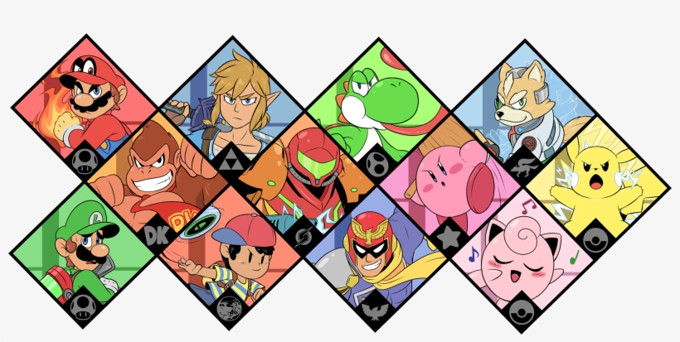
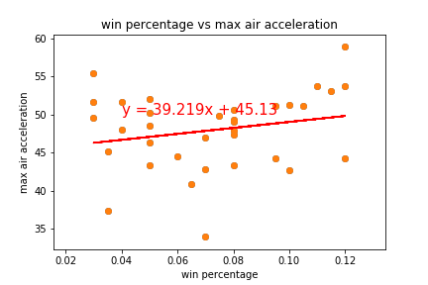
Max Acceleration
The correlation between the max air acceleration and win rate is 0.21871485563970847
The standard deviation between the max air acceleration and win rate is 0.047836188077498516
The pvalue between the max air acceleration and win rate is 0.21396889855098386

Slide 8
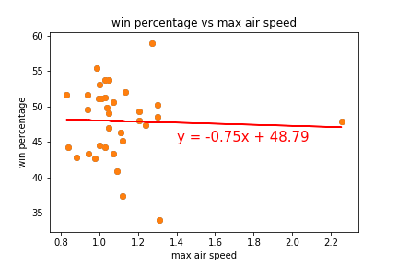
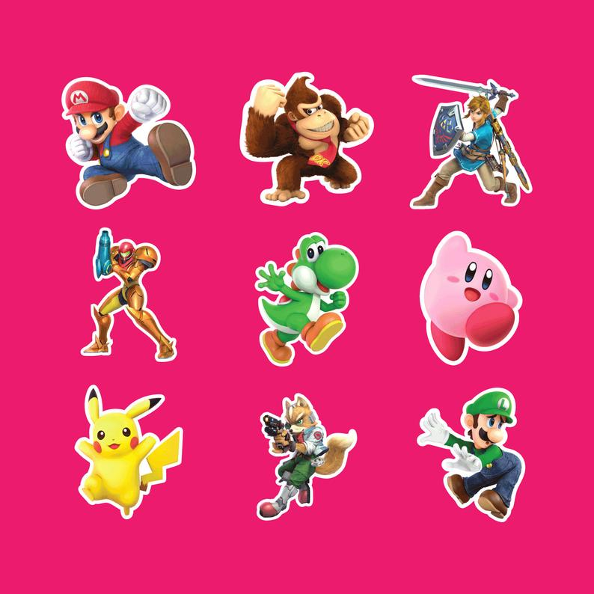
Max Air Speed
The correlation between the max air speed and win rate is -0.035012962316060464
The standard deviation between the max air speed and win rate is 0.0012259075301458702
The pvalue between the max air speed and win rate is 0.8441542171073813

Slide 9
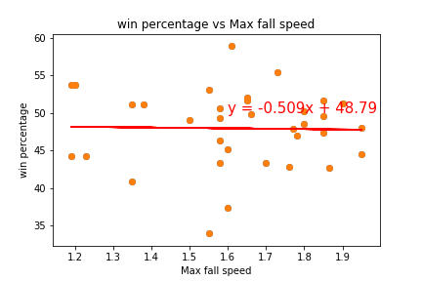
Max Fall Speed
The correlation between the max fall speed and win rate is -0.021853247565460806
The standard deviation between the max fall speed and win rate is 0.00047756442915731866
The pvalue between the max fall speed and win rate is 0.9023656844301093

Slide 10

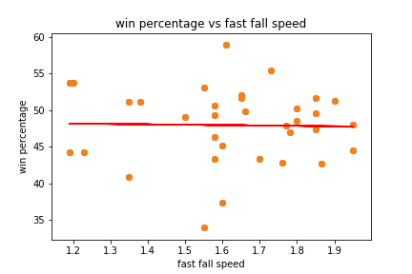
Fast Fall Speed
The correlation between the fast fall speed and win rate is -0.021853247565460806
The standard deviation between the fast fall speed and win rate is 0.00047756442915731866
The pvalue between the fast fall speed and win rate is 0.9023656844301093

Slide 11
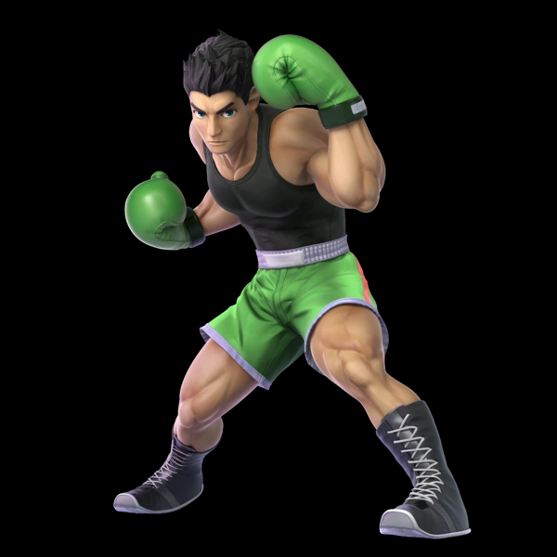
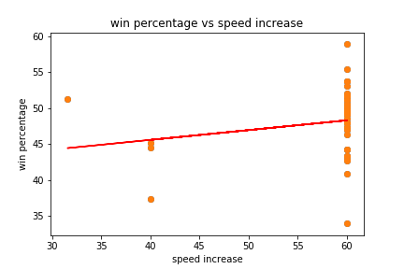
Speed Increase
The correlation between the speed increase and win rate is 0.19453821047691874
The standard deviation between the speed increase and win rate is 0.03784511533556194
The pvalue between the speed increase and win rate is 0.27024954991901556

Slide 12
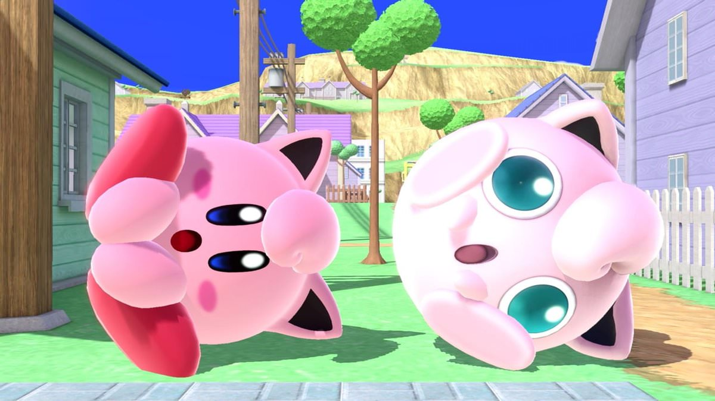
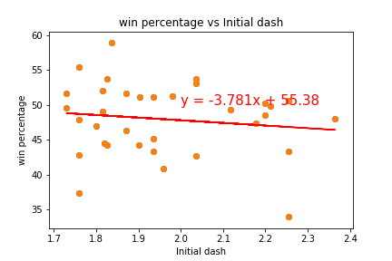
Initial Dash
The correlation between the initial dash and win rate is -0.135900257112974
The standard deviation between the initial dash and win rate is 0.018468879883372438
The pvalue between the initial dash and win rate is 0.4434660593092854

Slide 13
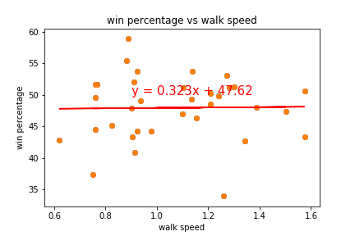

Walk Speed
The correlation between the walk speed and win rate is 0.015935423641648974
The standard deviation between the walk speed and win rate is 0.00025393772663882504
The pvalue between the walk speed and win rate is 0.9287253473495998

Slide 14
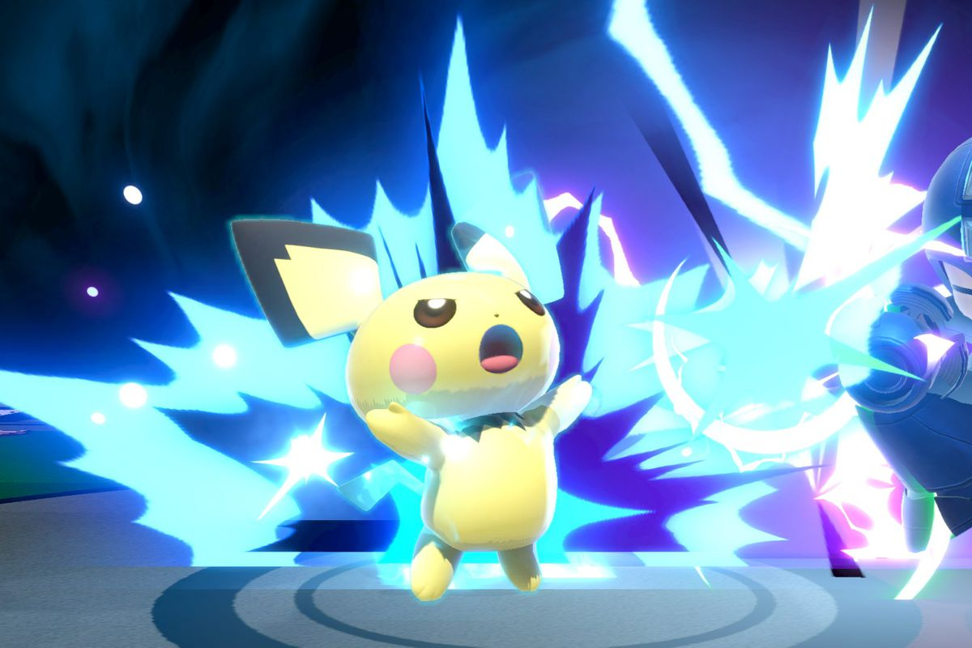
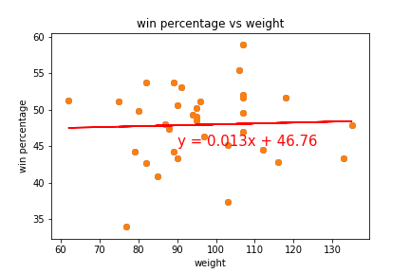
Weight
The correlation between the weight and win rate is 0.03845189510123973
The standard deviation between the weight and win rate is 0.001478548236876744
The pvalue between the weight and win rate is 0.8290622959731972

Slide 15
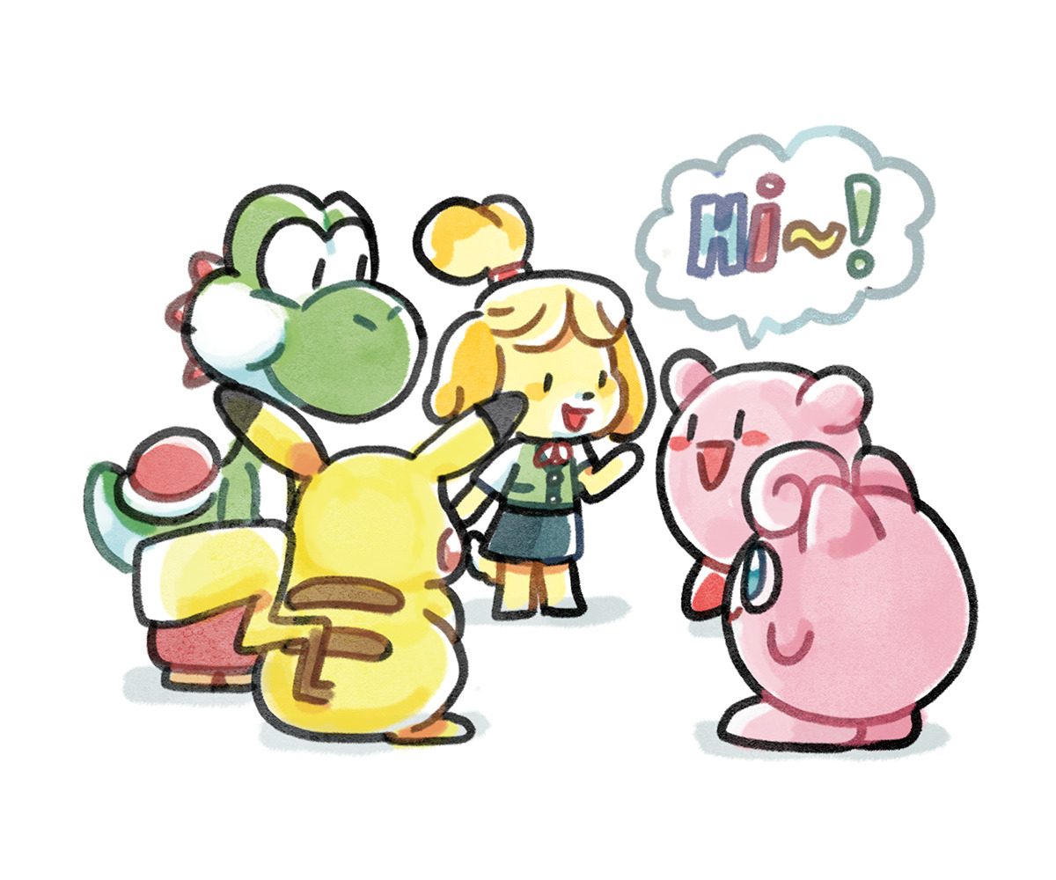
Overview of Problems
Incomplete and/or missing data
Character stats that we needed more time and data to account for
Blast zones
Character moves (ex: reflect and counters)
Special characters (ex: Pokemon Trainer)
How many times they were used in tournaments
Character specific stats that forced data to be on different stats that were on the API

Slide 16
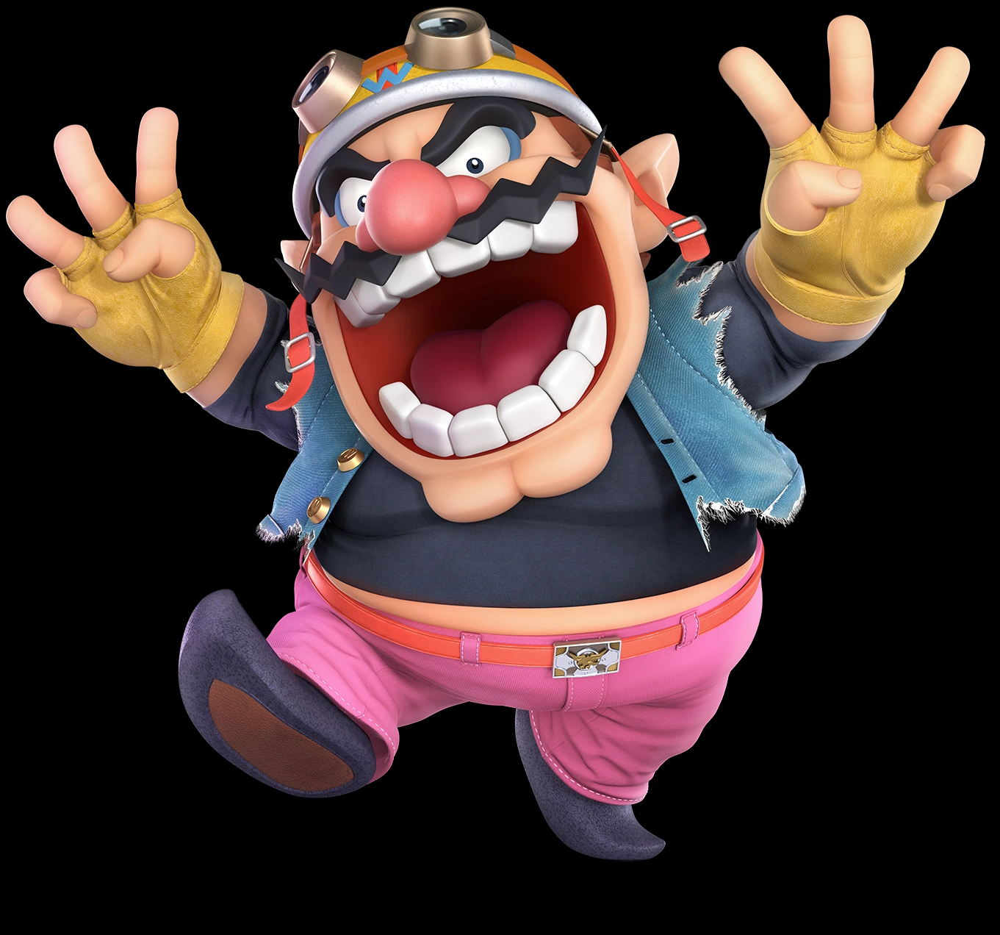
Analysis
Positive Correlation for the Win Rate
Negative Correlation for the Win Rate
Base Air Acceleration
Additional Acceleration
Max Acceleration
Speed Increase
Walk Speed
Weight
Max Air Speed
Max Fall Speed
Fast Fall Speed
Initial Dash

